Slide 1
ETMA Notifications
October, 2018

Slide 2
ETMA Notifications
The ETMA system provides Project Managers with built-in workflow management functionality, which will notify any assigned users in the system when a task on a job needs their attention.

Slide 3
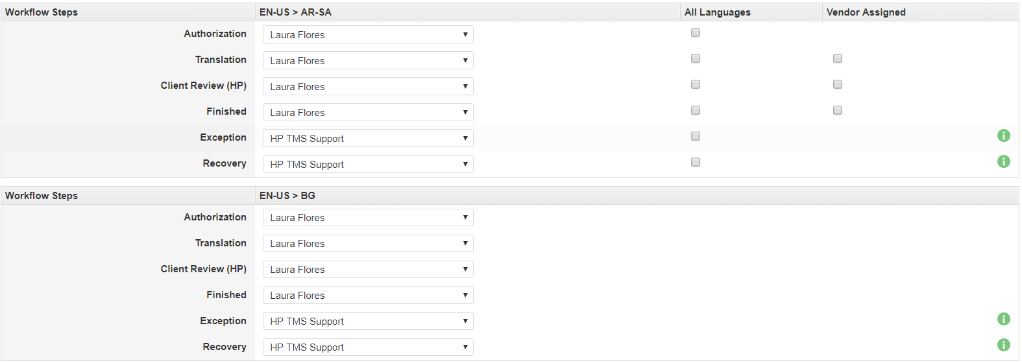
ETMA Notification – User Assignments
When you request a new workflow on ETMA, please ensure to let Service Desk Agents who will be the user assigned for All languages pairs. This information will be used by ETMA to notify this user every time a task is reaching this stage.

Slide 4
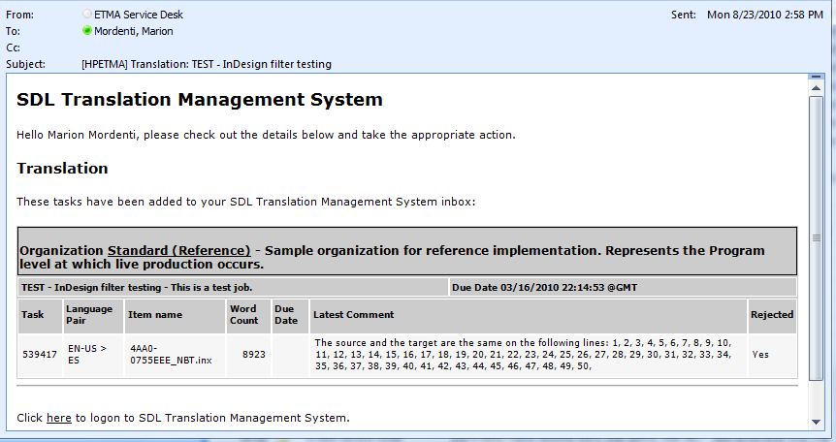
ETMA Notification – Sample from ETMA
What information will ETMA notification include?
Organization
job created in
Stage in
workflow
Due Date for
Entire job
Job Description
Job name
Language
Pair
Filename
in job
Total number of words
per file in job
Link to ETMA

Slide 5
Workflow shared between multiple PMs
Workflow human stages need to be assigned to one ETMA user, however for programs managed by multiple PMs you may have a need to share workflows, and therefore have different PM users assigned to specific workflow stages.
For this specific purpose, a broker (Broker: Assign Job Creator) is available on ETMA and can be used to automatically assign the job creator to the Authorization and Finished stages.
For more information or setup of this broker on your workflow, please log a case to the ETMA ServiceDesk

Slide 6
Exception and Recovery stage assignment
The Exception and Recovery workflow stages are by default assigned to ETMA user “HP TMS Support” (ETMA Service Desk), in order for them to act on this issues.

Slide 7
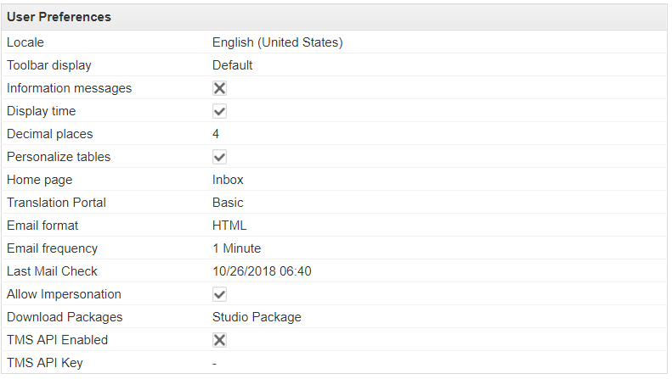
Verify Last Email Sent Information
In order to validate if ETMA successfully sent notifications. You may check the Last Email Check information in ETMA, under Home tab > My Details
This date and time indicates when ETMA sent the last notification to this user account.

Slide 8
Email Notification Submission Problem
If one email address on an ETMA account is invalid, log into ETMA with this user, under Home tab > My Details > click in Edit button, remove the invalid email, and click Submit to save changes.
Or log a case to the ETMA Service Desk to address the problem.

Slide 9
Thank you

